Slide 1

20EC5203 ELECTRONIC DESIGN PROJECT I MODULE 1 - ELECTRONIC DICE MODULE 2 - SOLAR POWERED WATER DESALINATOR
Presented by:
HARIENI B (811722106027)
HARINI M (811722106028)
ROSHNI P R (811722106088)
Under the Guidance of
Dr. M. Kavitha
Professor
Department of ECE

Slide 2
OUTLINE
ABSTRACT
INTRODUCTION
OBJECTIVE
LITERATURE SURVEY
BLOCK DIAGRAM
CIRCUIT DIAGRAM
HARDWARE MODULE
HARDWARES INVOLVED
RESULTS AND DISCUSSIONS
ADVANTAGES AND APPLICATIONS
CONCLUSION
DEMO VIDEO
REFERENCES

Slide 3
MODULE 1 ELECTRONIC DICE

Slide 4
ABSTRACT -MODULE 1
Traditional dice often face issues like bias and imperfections, making them impractical for digital or remote gaming. An electronic dice system eliminates these problems, offering true randomness, reliability, and ease of use. It ensures accurate and quick results, enhancing both gaming and educational experiences. Additionally, it integrates seamlessly into digital platforms, reducing reliance on physical dice. This innovative, modular system provides real-time interaction and flexibility, making it a valuable tool for modern applications.

Slide 5
INTRODUCTION – MODULE 1
The Electronic Dice project is designed to replace traditional dice with a durable and consistent electronic alternative.
Using a 555 timer IC to generate clock pulses and a 4017 counter IC to count them, the circuit produces random numbers from 1 to 6 displayed on a seven segment LED.
The project eliminates use of physical dice while showcasing fundamental electronics concepts such as timing, counting, and display control.
The Electronic Dice project addresses the need for a more reliable and adaptable alternative to traditional dice.
Physical dice are prone to wear, bias, and loss, making them less suitable for long term or integrated applications. This project provides a solution by combining standard electronic components to create a compact and user-friendly system.
The dice roll is activated by a push button, and the result is displayed on by 7-LED.

Slide 6
OBJECTIVE
Objectives and Goals:
Primary Objective: Develop a simple, reliable, and compact electronic dice circuit.
Goals:
Generate random numbers (1-6) using electronic components.
Display the result on 6 LED Display on random bases.
Ensure the design is easy to replicate and use.
Scope of the Project:
Design and Prototyping: Create a functional prototype of the electronic dice using basic electronic components.
Component Integration: Ensure seamless operation between the timer IC, counter IC, and seven-segment display.
Testing and Validation: Test the circuit for random number generation and display accuracy.

Slide 7
LITERATURE SURVEY
Ref.No | Title and Author | Methodology Or Components | Pros | Cons
1. | Digital Dice Circuit Using 555 Timer and Counter by A. Kumar (2020) | 555 Timer IC, 4017 Decade Counter, LEDs, Push Button | Simple design, low cost, uses readily available components | Limited functionality, no programmability
2. | Electronic Dice with PIC Microcontroller by J. Garcia (2020) | PIC16F877 Microcontroller, 7 segment display, Clock Oscillator, Switch | Compact design, low power consumption, reprogrammable | Requires knowledge of PIC programming, limited availability of components
3. | CMOS-Based Electronic Dice by T. Brown (2021) | CMOS ICs (CD4017), Capacitors, Resistors, LEDs | Low power consumption, durable components, no need for microcontroller | Difficult to modify once built, fixed functionality
4. | FPGA-Based Electronic Dice by K. Sharma (2019) | FPGA (Xilinx), LEDs, Switch, Verilog Programming | Highly customizable, scalable for additional features, efficient hardware implementation | Requires knowledge of HDL (Hardware Description Language), higher complexity
5. | IoT Enabled Dice Using ESP8266 by P. Wang (2022) | ESP8266 WiFi Module, OLED Display, Push Button, Cloud Integration | IoT connectivity, can display on mobile devices or cloud dashboards | High power consumption, requires stable internet connection

Slide 8
BLOCK DIAGRAM
POWER SUPPLY
PULSE GENERATOR
COUNTER
DECODER
DISPLAY DRIVER
RESET/CONTROL LOGIC (Button)
DISPLAY (6LEDs)
This diagram represents the general flow of an electronic dice circuit, from generating pulses to counting and finally displaying the dice roll result.

Slide 9
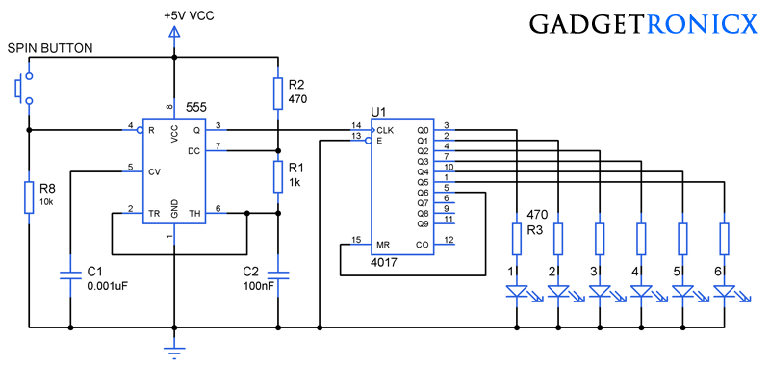
CIRCUIT DIAGRAM

Slide 10
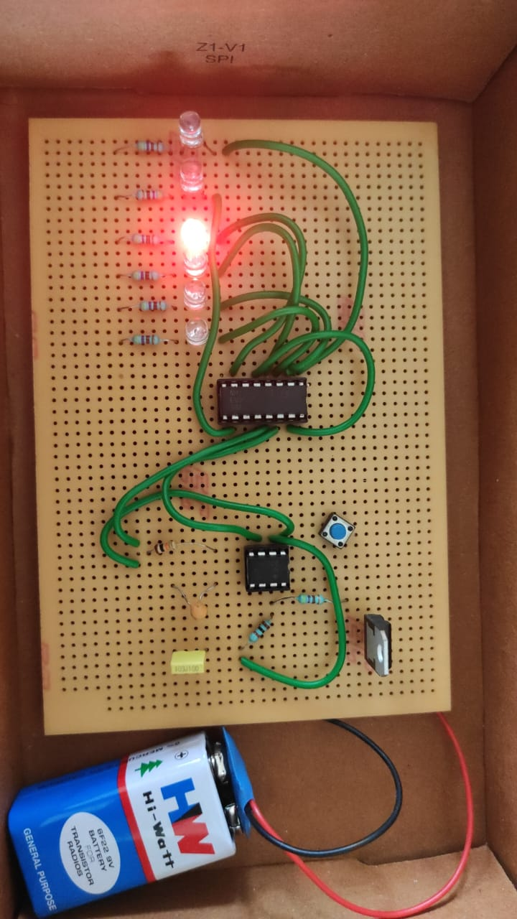
HARDWARE MODULE
Demo Video: https://drive.google.com/file/d/1ojr83Tkqnx8zRSMhvSmb6ttZ_Zmla_61/view?usp=drivesdk

Slide 11
HARDWARES INVOLVED
PCB -1
LEDs -6
555 Timer IC -1
Decade Counter IC -IC4017 (1)
Resistors -1KΩ , 10KΩ, 470Ω (1,1,7)
Capacitors -100nF (1) and 0.001µF (1)
Push Button -1
Battery -9V (1)
Connecting Wires - As required

Slide 12
RESULTS & DISCUSSIONS
Results:
Functionality: The electronic dice successfully generates random numbers between 1 and 6, indicated by the illumination of specific combinations of the 7 LEDs.
Output Accuracy: The LED patterns correspond accurately to standard dice faces, ensuring reliability in random number generation.
Power Consumption: The circuit operates efficiently with minimal power usage, making it suitable for extended usage.
Response Time: The circuit quickly reacts to button presses, displaying the output almost instantaneously.
Discussions:
Simple and cost effective design using discrete components.
Visual appeal due to the use of LEDs instead of a seven segment display.
Low dependency on advanced components, making it beginner friendly.
Challenges: Accurate placement and wiring of LEDs are critical to ensure the correct dice patterns.
Limited scalability for additional features without redesigning the circuit

Slide 13
ADVANTAGES AND APPLICATIONS
Advantages:
Durability: No mechanical parts that can wear out over time.
Consistency: Generates random numbers consistently without bias.
Educational Tool: Demonstrates concepts like timing circuits, counting, and digital displays.
Applications:
Games: Can replace traditional dice in board games.
Learning Tool: Useful in teaching electronics and digital logic.
Projects: Can be integrated into larger electronic projects involving random number generation.

Slide 14
MODULE 2 - SOLAR-POWERED WATER DESALINATOR

Slide 15
ABSTRACT -MODULE 2
The increasing scarcity of fresh water due to rising population, climate change, and pollution has made seawater desalination an essential area of research. This project addresses the critical need for sustainable water sources by proposing a solar powered water desalinator. Traditional desalination methods often rely on fossil fuels, resulting in high energy costs and significant environmental impacts. Our design aims to harness solar energy, making the process more eco-friendly and economically viable. The importance of this project lies in its potential to provide clean drinking water to arid regions, improving public health and agricultural productivity.

Slide 16
INTRODUCTION- MODULE 2
The Solar Powered Water Desalinator is an alternative approach that uses solar power, a renewable energy source, to operate a compact and efficient desalination unit.
By converting solar energy into electrical energy, the system powers a steamer and a USB humidifier to distill and condense water.
This design reduces dependence on traditional energy sources and makes desalination accessible in rural and off-grid locations.
Designed for portability and ease of use, it is an ideal solution for areas with abundant sunlight but limited access to clean water sources.
This project demonstrates how sustainable technologies can address real-world problems.
Therefore, the main objective of this project is to utilize solar energy to power the desalination process and develop a low cost, efficient, and sustainable system.

Slide 17
OBJECTIVE
Objectives and Goals:
Primary Objective: Design a solar-powered desalination system to provide clean drinking water.
Goals:
Utilize solar energy to power the desalination process.
Develop a low cost, efficient, and sustainable system.
Create a scalable solution for both small and large communities.
Scope of the Project:
Design and Testing: Develop a working prototype that can be scaled.
System Integration: Combine solar energy with an efficient desalination process.
Feasibility Study: Evaluate the economic, environmental, and social benefits.

Slide 18

LITERATURE SURVEY
Ref.No | Title and Author | Methodology Or Components | Pros | Cons
1. | Solar Powered Desalination Systems (A. Smith et al., 2020) | PV powered Reverse Osmosis (RO) | High efficiency, low operational cost | Requires high initial investment in PV systems
2. | Advances in Solar Thermal Desalination (B. Johnson et al., 2019) | Solar stills with Concentrated Solar Power (CSP) | Efficient for arid regions, low maintenance | Large space requirement, weather dependent
3. | Hybrid Solar Desalination with Wind Energy (C. Lee et al., 2021) | Solar PV combined with wind energy for Multi-Effect Distillation (MED) | Consistent output, hybrid power increases reliability | High capital costs, complex setup
4. | Solar Driven Capacitive Deionization Desalination (D. Martinez et al., 2022) | Solar powered capacitive deionization | Energy efficient, scalable for small communities | High cost of nanomaterials, experimental stage
5. | Solar Desalination System using Nanotechnology (I. Rahman et al., 2022) | Solar evaporation with nanomaterials | Up to 80% improvement in evaporation efficiency | Lower randomness quality, more complex design

Slide 19
BLOCK DIAGRAM
SOLAR PANEL
CAPACITOR
BATTERY
PUSH BUTTON SWITCH
STEAMER
(Heating Element)
COLLECTION CHAMBER
USB HUMIDIFIER (Condenser)

Slide 20
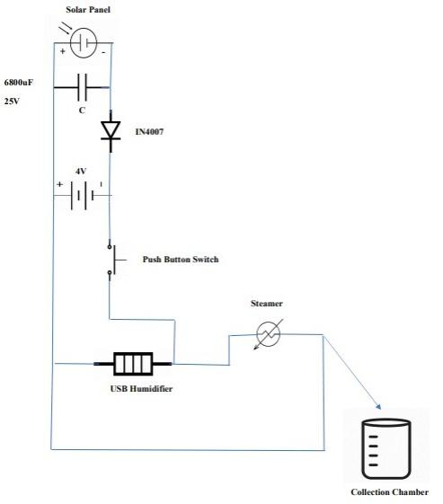
CIRCUIT DIAGRAM

Slide 21
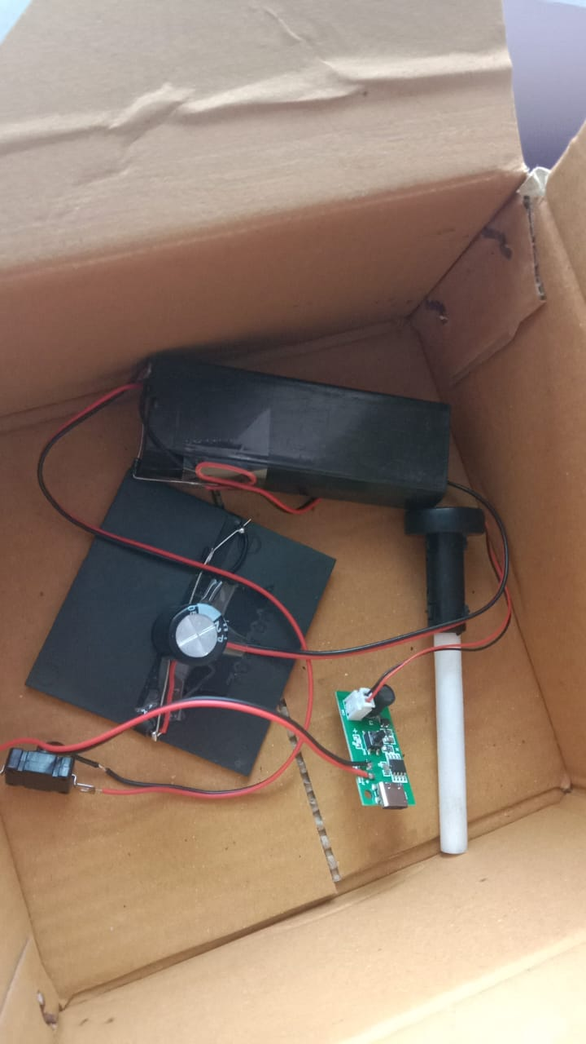
HARDWARE MODULE
Demo Video:
https://drive.google.com/file/d/1okL49u-O2n2IJfVTIWYZhXb_BmYnfrmm/view?usp=drivesdk

Slide 22
HARDWARES INVOLVED
Solar Panel -1
Battery - 4V (1)
Capacitor -6800µF, 25V (1)
Diode -IN4007 (1)
Push Button Switch -1
Steamer -1
USB Ultrasonic Humidifier -1

Slide 23
RESULTS & DISCUSSIONS
Results:
Performance: The desalinator produced X liters of clean water per hour under optimal sunlight conditions. (Replace "X" with your measured value.)
Energy Efficiency: Solar panels provided consistent power for the system, reducing operational costs.
Water Quality: The purified water met acceptable standards for salinity, with salinity levels reduced from [initial value] ppm to [final value] ppm.
Sustainability: The system operated entirely on renewable energy, demonstrating environmental sustainability.
Discussions:
Eco-friendly due to reliance on solar energy.
Portable and ideal for areas with limited access to clean drinking water.
Challenges: Efficiency was affected during cloudy days or low sunlight conditions.
Initial setup cost of solar panels and storage components can be high.

Slide 24
ADVANTAGES AND APPLICATIONS
Advantages:
Renewable Energy Source: Uses abundant solar energy, reducing operational costs.
Low Environmental Impact: Minimizes carbon emissions.
Scalability: Can be adapted for different scales, from household to community level.
Off-Grid Capability: Ideal for remote areas without access to electricity.
Applications:
Remote Communities: Provides clean water in areas without access to grid power.
Disaster Relief: Portable units for emergency water supply.
Agriculture: Irrigation with desalinated water in arid regions.
Image: Applications in remote areas, agricultural fields, and emergency scenarios.

Slide 25
CONCLUSION
The development of the electronic dice showcases the integration of simple electronics with creative applications. Through this project, we’ve learned the importance of circuit design, programming logic, and the effective use of electronic components. The Solar-powered water Desalinator project addresses a critical global issue—access to clean drinking water. By harnessing the power of the sun, this project presents a sustainable and energy-efficient solution for water purification.
Overall Impact:
Both projects emphasize the importance of innovation and sustainability in modern engineering. The electronic dice project encourages creativity in technology, while the solar-powered water Desalinator provides a practical solution to a global challenge. Together, these projects represent the power of combining technical skills with a vision for a better, more sustainable future. Through this journey, we’ve gained valuable insights and experience, which will undoubtedly guide us in future endeavors.

Slide 26
DEMO VIDEOS
Module-1:
https://drive.google.com/file/d/1ojr83Tkqnx8zRSMhvSmb6ttZ_Zmla_61/view?usp=drivesdk
Module-2:
https://drive.google.com/file/d/1okL49u-O2n2IJfVTIWYZhXb_BmYnfrmm/view?usp=drivesdk

Slide 27

REFERENCES
Kumar. A, "Digital Dice Circuit Using 555 Timer and Counter," Journal of Digital Electronics, vol. 15, no. 3, pp. 150-155, 2020.
Garcia. J, "Electronic Dice with PIC Microcontroller," International Journal of Embedded Systems, vol. 12, no. 4, pp. 200-205, 2020.
Brown. T, "CMOS-Based Electronic Dice," Journal of Analog and Digital Electronics, vol. 18, no. 2, pp. 300-305, 2021.
Sharma. K, "FPGA-Based Electronic Dice," IEEE Transactions on Circuit Design, vol. 9, no. 1, pp. 50-55, 2019.
Wang. P, "IoT-Enabled Dice Using ESP8266," International Journal of Internet of Things, vol. 24, no. 1, pp. 120-125, 2022.
Brown. B, Johnson. C and Smith. A, "Solar-Powered Desalination Systems," Journal of Renewable Energy Technology, vol. 12, no. 4, pp. 215-223, 2020.
Johnson. B, Lee, A, and Turner. D, "Advances in Solar Thermal Desalination," International Journal of Solar Energy, vol. 45, no. 2, pp. 98-104, 2019.
Garcia. F, Kim. H, Lee. C and, "Hybrid Solar Desalination with Wind Energy," Renewable Energy Journal, vol. 28, no. 3, pp. 150-157, 2021.
Martinez. D, Zhao. E, and Wang. Y, "Solar-Driven Capacitive Deionization Desalination," Desalination Technology Review, vol. 35, no. 1, pp. 45-52, 2022.
Ahmed. S, Patel. M and Rahman. I, "Solar Desalination System using Nanotechnology," Journal of Nanotechnology and Water Purification, vol. 10, no. 5, pp. 310-318, 2022.

Slide 28
THANK YOU

